Slide 1
Wireless Fundamentals

Slide 2
Differences Between WLAN and LAN
  WLANs use radio waves as the physical layer.
    WLANs use CSMA/CA instead of CSMA/CD for media access.
    Two-way radio (half-duplex) communication.
  Radio waves have problems that are not found on wires.
    Connectivity issues:
      Coverage problems
      Interference, noise
    Privacy issues
  Access points are shared devices similar to an Ethernet hub for shared bandwidth.
  WLANs must meet country-specific RF regulations.

Slide 3
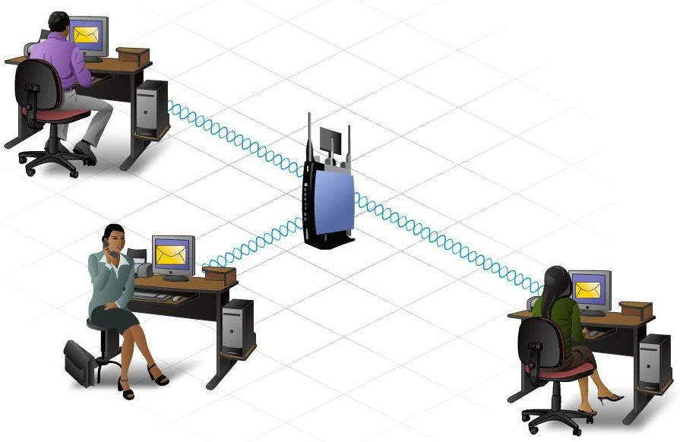
Benefits of Wireless
Mobility
Scalability
  can be added to a network easily
  use of “hotspots”
Flexibility
  anytime, anywhere connectivity
Cost
  inexpensive to install
  reduced installation costs

Slide 4
Limitations/Risks of Wireless
Uses unlicensed regions of the RF spectrum
  used by many different devices
Interference
  cordless phones
  microwaves
Security
  easy access to the network
  encryption/authentication helps with security issues

Slide 5
Types of Wireless Networks
  Wireless Personal-Area Network (WPAN) – Low power and short-range (20-30ft or 6-9 meters). Based on IEEE 802.15 standard and 2.4 GHz frequency. Bluetooth and Zigbee are WPAN examples.
  Wireless LAN (WLAN) – Medium sized networks up to about 300 feet. Based on IEEE 802.11 standard and 2.4 or 5.0 GHz frequency.
  Wireless MAN (WMAN) – Large geographic area such as city or district. Uses specific licensed frequencies.
  Wireless WAN (WWAN) – Extensive geographic area for national or global communication. Uses specific licensed frequencies.

Slide 6
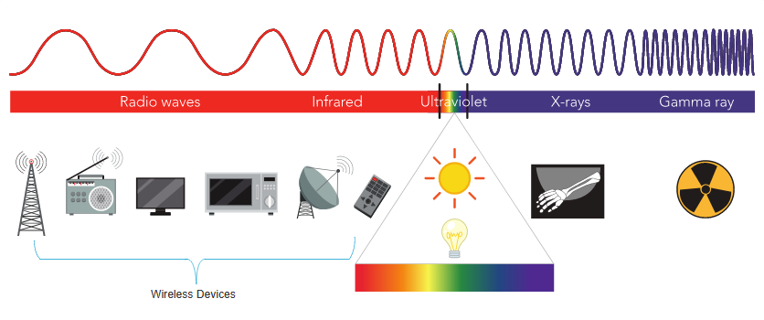
Radio Frequencies
  All wireless devices operate in the range of the electromagnetic spectrum. WLAN networks operate in the 2.4 and 5 GHz frequency bands.
  2.4 GHz (UHF) – 802.11b/g/n/ax
  5 GHz (SHF) – 802.11a/n/ac/ax

Slide 7
Radio Frequency (RF)
Signal able to transmit through walls
RF bands set aside for wireless devices, including cordless phones and computer peripherals
900 MHz – used by cell phones
2.4 GHz
    Bluetooth technology
    low speed, short range
    can communicate with many devices at once
5 GHz
    Wireless LAN
    transmit at a higher level = greater distance
    conform to 802.11 standards

Slide 8
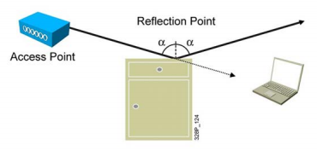

RF Principles
Reflections: When the radio wave hits the obstacle at a low angle, the wave (the entire wave, or part of it) might bounce on the obstacle. This phenomenon is called reflection.
Refraction: Refraction occurs when a wave changes direction. This change in direction usually happens when a wave passes from one medium to another (from air to water, for example).

Slide 9
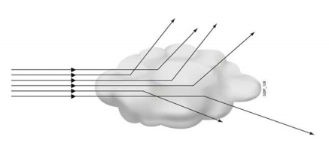
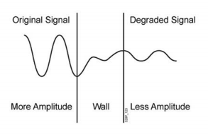
RF Principles
Absorption: When radio waves go through 'something' (some material), they generally get weakened or dampened. How much they lose in power will depend on the material.
Scattering: Reflection also occurs in the air itself, bouncing on dust or micro drops of water (humidity). These multiple reflections are described as scattering.

Slide 10
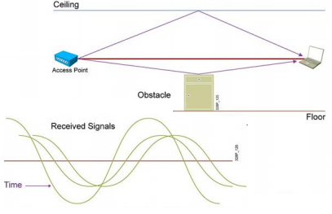
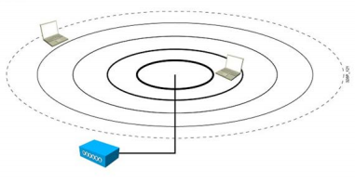
RF Principles
Multipath: A signal sent to a station travels in a straight line and reaches the destination. A few microseconds later, copies of the same signal reflected on walls, ceiling, and obstacles also reach the destination.
Free Path Loss: Even without obstacles, a radio wave gets weaker as it moves away from the emitting source because the energy of the wave spreads.

Slide 11
Frequency Channel Saturation
If the demand for a specific wireless channel is too high, the channel may become oversaturated, degrading the quality of the communication.
Channel saturation can be mitigated using techniques that use the channels more efficiently.
  Direct-Sequence Spread Spectrum (DSSS) - A modulation technique designed to spread a signal over a larger frequency band. Used by 802.11b devices to avoid interference from other devices using the same 2.4 GHz frequency.
  Frequency-Hopping Spread Spectrum (FHSS) - Transmits radio signals by rapidly switching a carrier signal among many frequency channels. Sender and receiver must be synchronized to “know” which channel to jump to. Used by the original 802.11 standard.
  Orthogonal Frequency-Division Multiplexing (OFDM) - A subset of frequency division multiplexing in which a single channel uses multiple sub-channels on adjacent frequencies. OFDM is used by a number of communication systems including 802.11a/g/n/ac.

Slide 12
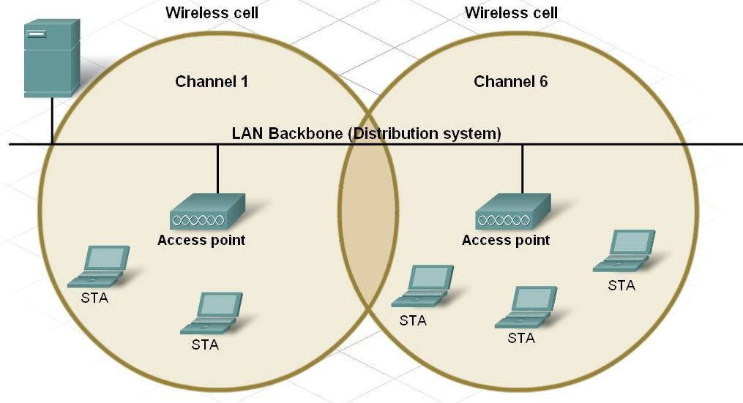
Channels in a WLAN
Use of channels help to control conversations
  allows multiple Access Points close to one another to function
  each AP must be on different channel
Each channel capable of carrying a different conversation

Slide 13
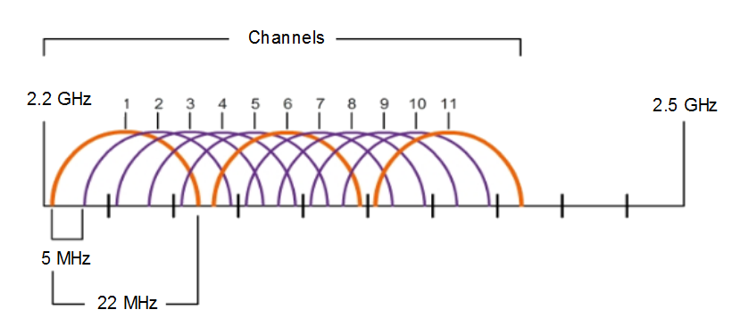
Channel Selection
The 2.4 GHz band is subdivided into multiple channels each allotted 22 MHz bandwidth and separated from the next channel by 5 MHz.
A best practice for 802.11b/g/n WLANs requiring multiple APs is to use non-overlapping channels such as 1, 6, and 11.

Slide 14
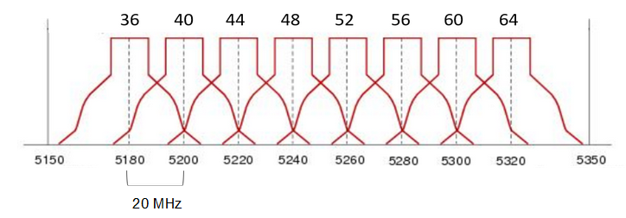
Channel Selection (Cont.)
For the 5GHz standards 802.11a/n/ac, there are 24 channels. Each channel is separated from the next channel by 20 MHz.
Non-overlapping channels are 36, 48, and 60.

Slide 15
802.11 Standards
  802.11 WLAN standards define how radio frequencies are used for wireless links.
IEEE Standard | Radio Frequency | Description
802.11 | 2.4 GHz | Data rates up to 2 Mb/s
802.11a | 5 GHz | Data rates up to 54 Mb/s Not interoperable with 802.11b or 802.11g
802.11b | 2.4 GHz | Data rates up to 11 Mb/s Longer range than 802.11a and better able to penetrate building structures
802.11g | 2.4 GHz | Data rates up to 54 Mb/s Backward compatible with 802.11b
802.11n | 2.4 and 5 GHz | Data rates 150 – 600 Mb/s Require multiple antennas with MIMO technology
802.11ac | 5 GHz | Data rates 450 Mb/s – 1.3 Gb/s Supports up to eight antennas
802.11ax | 2.4 and 5 GHz | High-Efficiency Wireless (HEW) Capable of using 1 GHz and 7 GHz frequencies

Slide 16
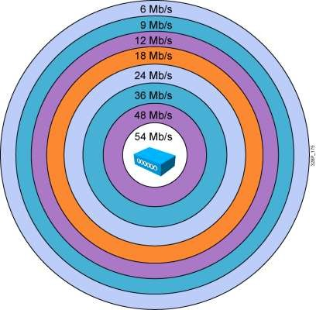
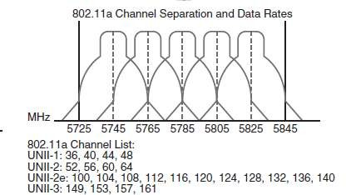
802.11a Standard
continue…
The 802.11a amendment was published in 1999.
802.11a uses OFDM only (6 Mbps to 54 Mbps).
802.11a offers up to 23 nonoverlapping channels.( 36, 44, 52, 60)
Operates in the 5-GHz band.

Slide 17
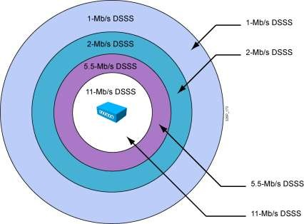
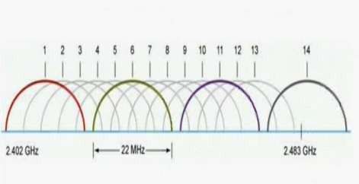
802.11b Standard
continue…
The 802.11b was published in 1999 and modified almost as soon as it was created to allow for faster speeds.
Data rate to 5.5 Mbps and 11 Mbps.
There are 3 nonoverlapping channels: 1, 6, 11.
Operates in the 2.4-GHz band.

Slide 18
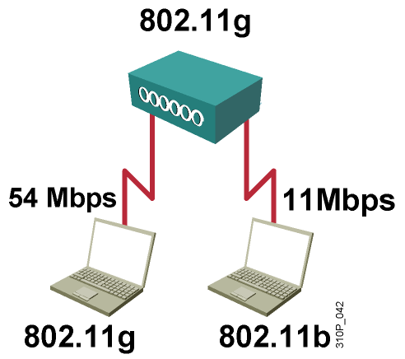
802.11g Standard
  Standard was ratified June 2003
  Operates in the 2.4-GHz band
  Same three nonoverlapping channels: 1, 6, 11
  12 data rates of up to 54 Mbps
    1, 2, 5.5, 11 Mbps (DSSS / 802.11b)
    6, 9, 12, 18, 24, 36, 48, 54 Mbps (OFDM)
  Full backward compatiblity to 802.11b standard but 802.11b stations cannot decode 802.11g radio signals.
Notes:
802.11g was ratified in June 2003. The speeds of 802.11g promised to be similar to 802.11a, and because it uses the exact same frequencies as 802.11b, it has full backward compatibility to 802.11b.
Equipment complying with 802.11g operates in the same modulation as 802.11b for 11-, 5.5-, 2-, and 1-Mbps data rates.
Equipment complying with 802.11g operates in the same modulation as 802.11a for 54-, 48-, 36-, 24-, 18-, 12-, 9- and 6-Mbps data rates.
Equipment complying with 802.11g operates in the same bandwidth as 802.11b for 22-MHz-wide channels.
The aim was to provide higher data rates than the 802.11b standard.
By using the 2.4 GHz band backward compatibility was possible with existing 802.11b Wireless LANs.
Same three non-overlapping channels 1, 6, 11
11- N/A;13- ETSI; 14- Japan
DSSS (CCK) and OFDM transmission
12 Data rates of up to 54 Mbps
1, 2, 5.5, 11 Mbps (DSSS / 802.11b)
6, 9, 12, 18, 24, 36, 48, 54 Mbps (OFDM)
Same transmission as 802.11b for:
11, 5.5, 2 and 1 Mbps data rates
Same transmission as 802.11a for:
54, 48, 36, 24, 18, 12, 9 and 6 Mbps data rates
Same bandwidth as 802.11b
22MHz wide channels
Full backward compatiblity to 802.11b standard

Slide 19
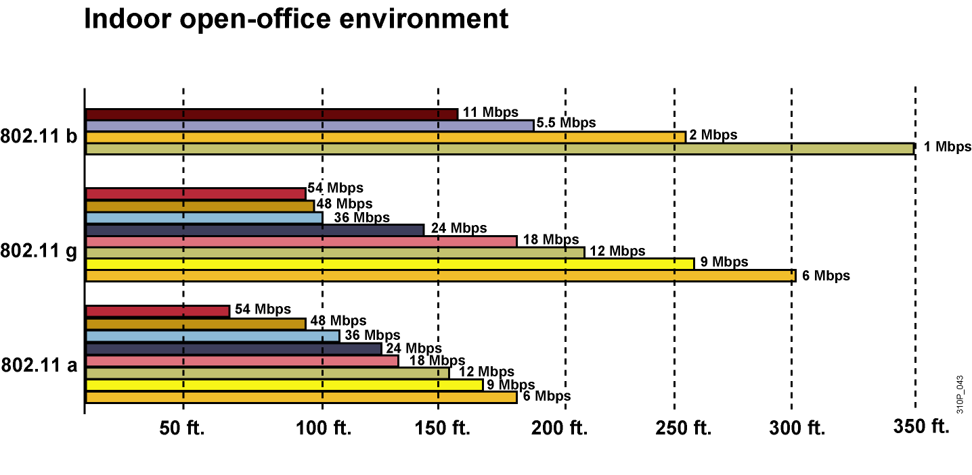
Range Comparisons
Notes:
The 11b and 11g ranges are based on default power settings with 2.2 dBi 2.4 GHz antennas on the AP’s and 0 dBi antennas on the clients.
The 11a ranges are based on default power settings with 5dBi Omni on the AP and 6 dBi Omni on the client.
This slides compares the range of the different data rates and the different wires LAN standards in an open office environment.
Actual distances can be different due to absorption and reflection.
The size of a wireless cell depends on the data rate.
It is possible to limit the range by disabling lower data rates.
To limit the range to 150ft data rates of 5.5, 2, and 1 Mbps (802.1b/g) and 6, 9, 12, 18 Mbps (802.11g) could be disabled.

Slide 20
802.11n Standard
The 802.11n was published in 2009
Operates at the 2.4 GHz or less than 5GHz Bands. Great in 5GHz, not so good in 2.4 GHz
9 to 11 non-overlapping 40 MHz channels in 5GHz
1.5 non-overlapping channels in 2.4GHz
Data rates from 54 Mbit/s to 450 Mbit/s

Slide 21
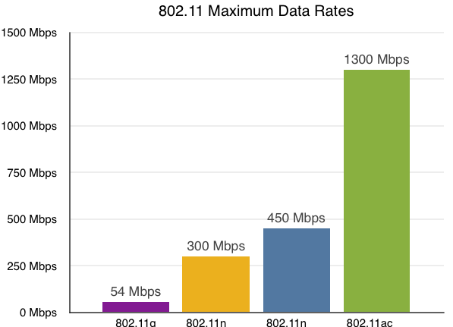
802.11ac Standard
Release in December 2013
It is an amendment to IEEE 802.11
Operates at 5GHz band with Data rates up to 1300 Mbit/s

Slide 22
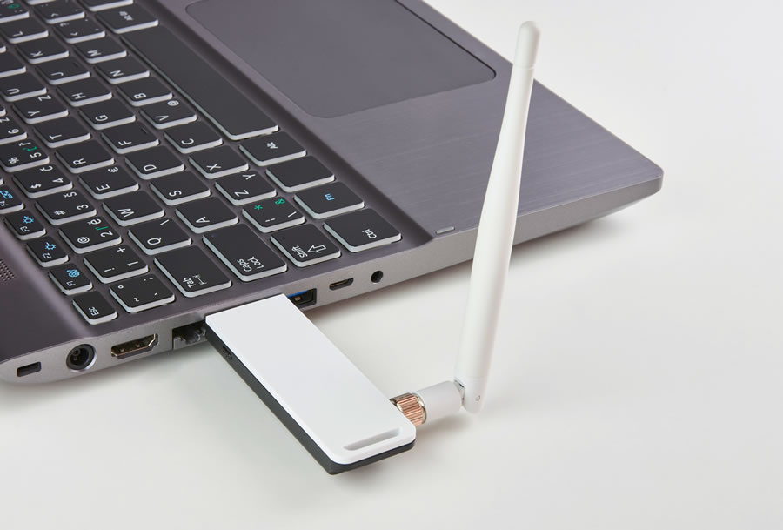
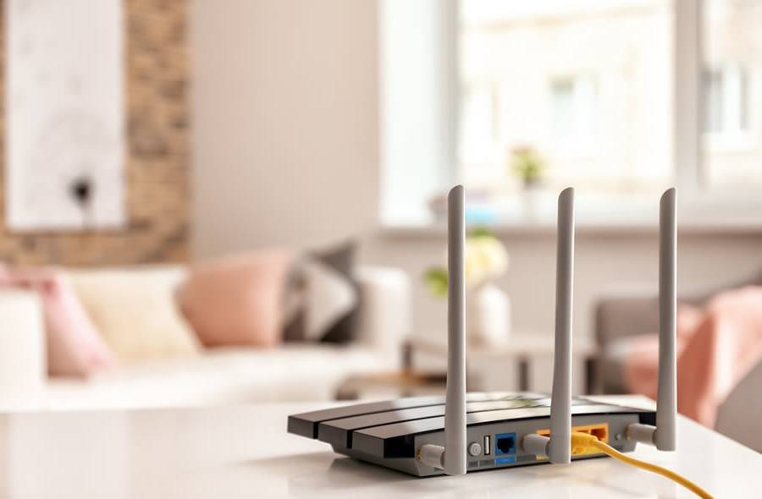
WLAN Components
Wireless NICs
To communicate wirelessly, laptops, tablets, smart phones, and even the latest automobiles include integrated wireless NICs that incorporate a radio transmitter/receiver.
If a device does not have an integrated wireless NIC, then a USB wireless adapter can be used.
Wireless Home Router
A home user typically interconnects wireless devices using a small, wireless router.
Wireless routers serve as the following:
    Access point – To provide wires access
    Switch – To interconnect wired devices
    Router - To provide a default gateway to other networks and the Internet

Slide 23
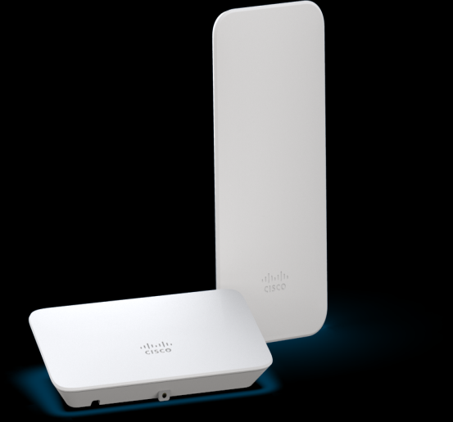
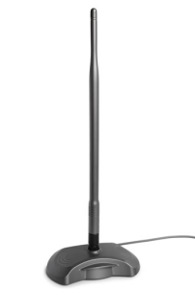
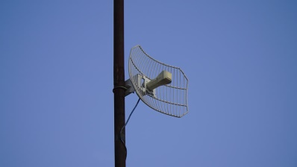

WLAN Components (Cont).
Wireless Access Point
Wireless clients use their wireless NIC to discover nearby access points (APs).
Clients then attempt to associate and authenticate with an AP.
After being authenticated, wireless users have access to network resources.
Wireless Antennas
Types of external antennas:
    Omnidirectional – Provide 360-degree coverage. Ideal in houses and office areas.
    Directional – Focus the radio signal in a specific direction. Examples are the Yagi and parabolic dish.
    Multiple Input Multiple Output (MIMO) – Uses multiple antennas (Up to eight) to increase bandwidth.

Slide 24
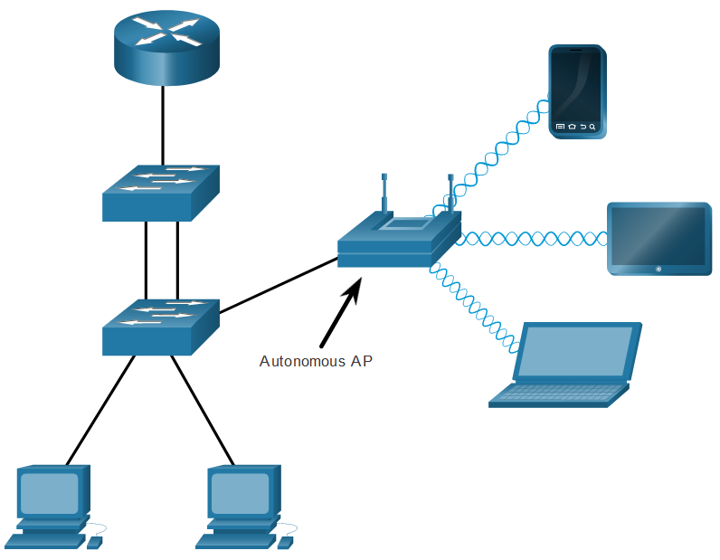
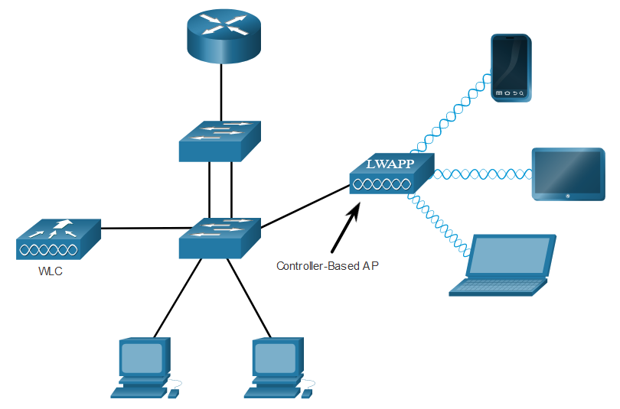
AP Categories
APs can be categorized as either autonomous APs or controller-based APs.
  Autonomous APs – Standalone devices configured through a command line interface or GUI. Each autonomous AP acts independently of the others and is configured and managed manually by an administrator.
  Controller-based APs – Also known as lightweight APs (LAPs). Use Lightweight Access Point Protocol (LWAPP) to communicate with a LWAN controller (WLC). Each LAP is automatically configured and managed by the WLC.

Slide 25
WLAN Operation

Slide 26

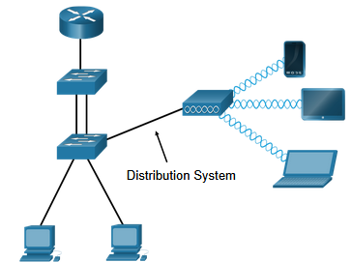
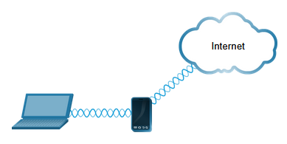
Wireless Topology Modes
  Ad hoc mode - Used to connect clients in peer-to-peer manner without an AP.
  Infrastructure mode - Used to connect clients to the network using an AP.
  Tethering - Variation of the ad hoc topology is when a smart phone or tablet with cellular data access is enabled to create a personal hotspot.

Slide 27
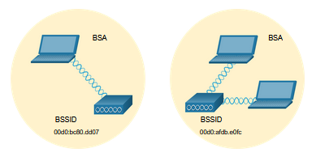
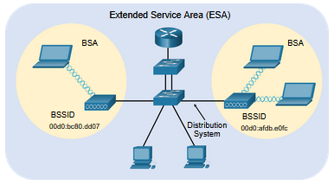
BSS and ESS
  Infrastructure mode defines two topology blocks:
  Basic Service Set (BSS)
    Uses single AP to interconnect all associated wireless clients.
    Clients in different BSSs cannot communicate.
  Extended Service Set (ESS)
    A union of two or more BSSs interconnected by a wired distribution system.
    Clients in each BSS can communication through the ESS.

Slide 28
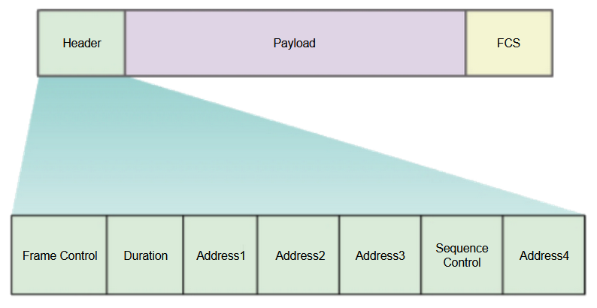
802.11 Frame Structure
  The 802.11 frame format is similar to the Ethernet frame format, except that it contains more fields.

Slide 29
CSMA/CA
  WLANs are half-duplex and a client cannot “hear” while it is sending, making it impossible to detect a collision.
  WLANs use carrier sense multiple access with collision avoidance (CSMA/CA) to determine how and when to send data. A wireless client does the following:
  Listens to the channel to see if it is idle, i.e. no other traffic currently on the channel.
  Sends a ready to send (RTS) message the AP to request dedicated access to the network.
  Receives a clear to send (CTS) message from the AP granting access to send.
  Waits a random amount of time before restarting the process if no CTS message received.
  Transmits the data.
  Acknowledges all transmissions. If a wireless client does not receive an acknowledgment, it assumes a collision occurred and restarts the process

Slide 30
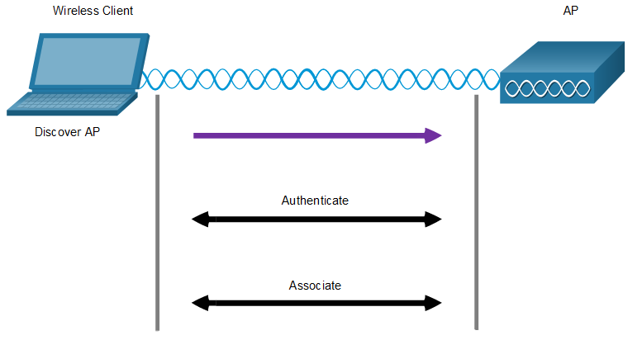
Wireless Client and AP Association
  For wireless devices to communicate over a network, they must first associate with an AP or wireless router.
  Wireless devices complete the following three stage process:
  Discover a wireless AP
  Authenticate with the AP
  Associate with the AP

Slide 31
Wireless Client and AP Association (Cont.)
  To achieve successful association, a wireless client and an AP must agree on specific parameters:
  SSID – The client needs to know the name of the network to connect.
  Password – This is required for the client to authenticate to the AP.
  Network mode – The 802.11 standard in use.
  Security mode – The security parameter settings, i.e. WEP, WPA, or WPA2.
  Channel settings – The frequency bands in use.

Slide 32
Purpose of SSID
Allows wireless components to connect to the WLAN
  tells wireless devices which WLAN they belong to
  tells devices whom then can talk to
All wireless devices must have same SSID to communicate with each other
Characteristics
  case sensitive
  alphanumeric characters
  sent in the header of the frame

Slide 33
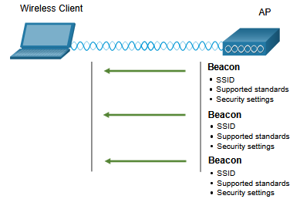
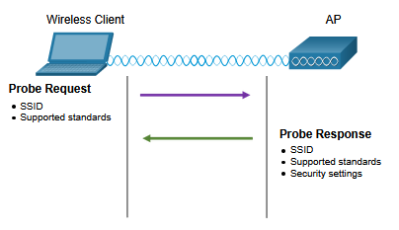
Passive and Active Discover Mode
Wireless clients connect to the AP using a passive or active scanning (probing) process.
  Passive mode – AP openly advertises its service by periodically sending broadcast beacon frames containing the SSID, supported standards, and security settings.
  Active mode – Wireless clients must know the name of the SSID. The wireless client initiates the process by broadcasting a probe request frame on multiple channels.
Passive mode
Active mode

Slide 34
Wireless Network Basic Architecture

Slide 35
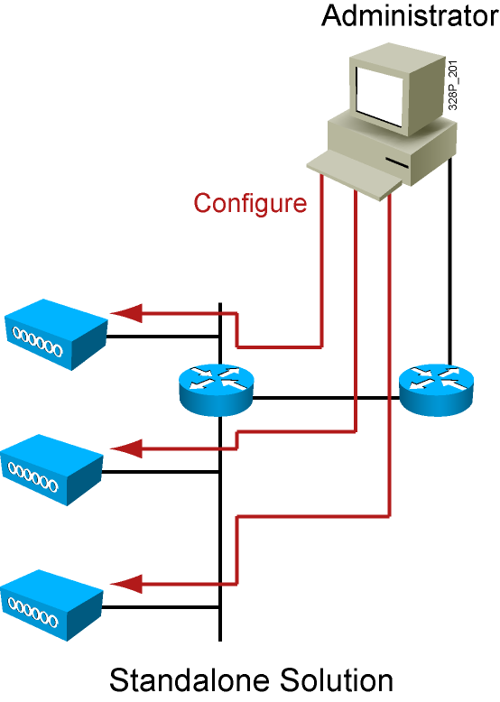
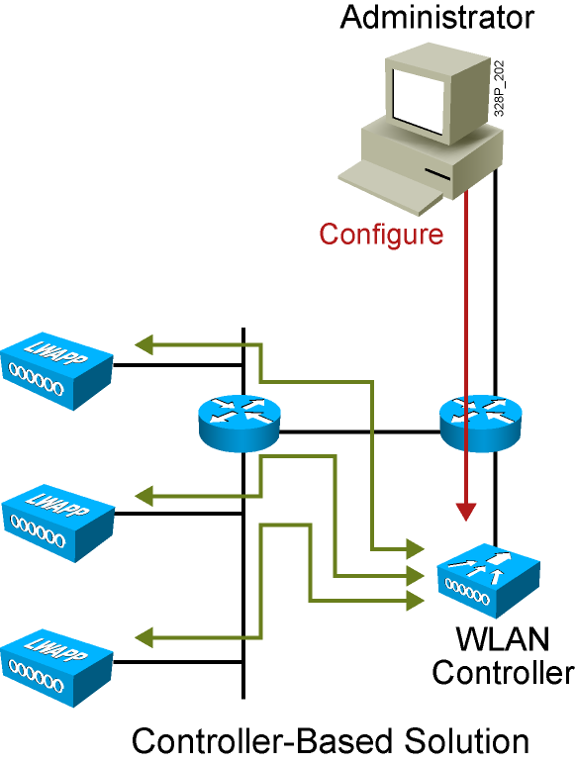
Standalone and Lighweight AP

Slide 36
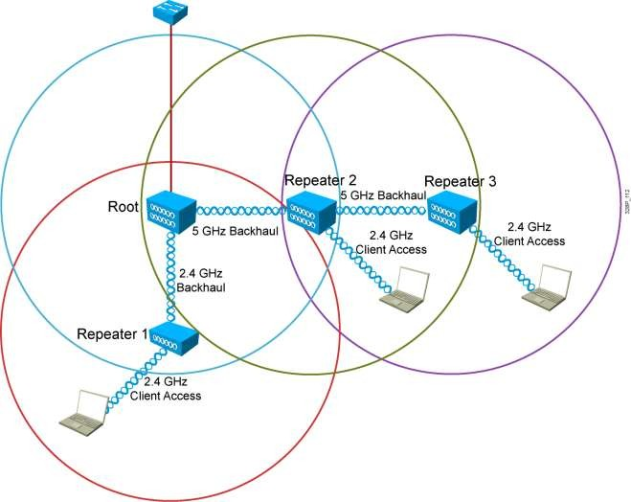
Repeater
Extends the AP coverage
Dual radio can create dual half- duplex
Overlap of 50% required
Throughput impacted when single frequency used
1-19

Slide 37
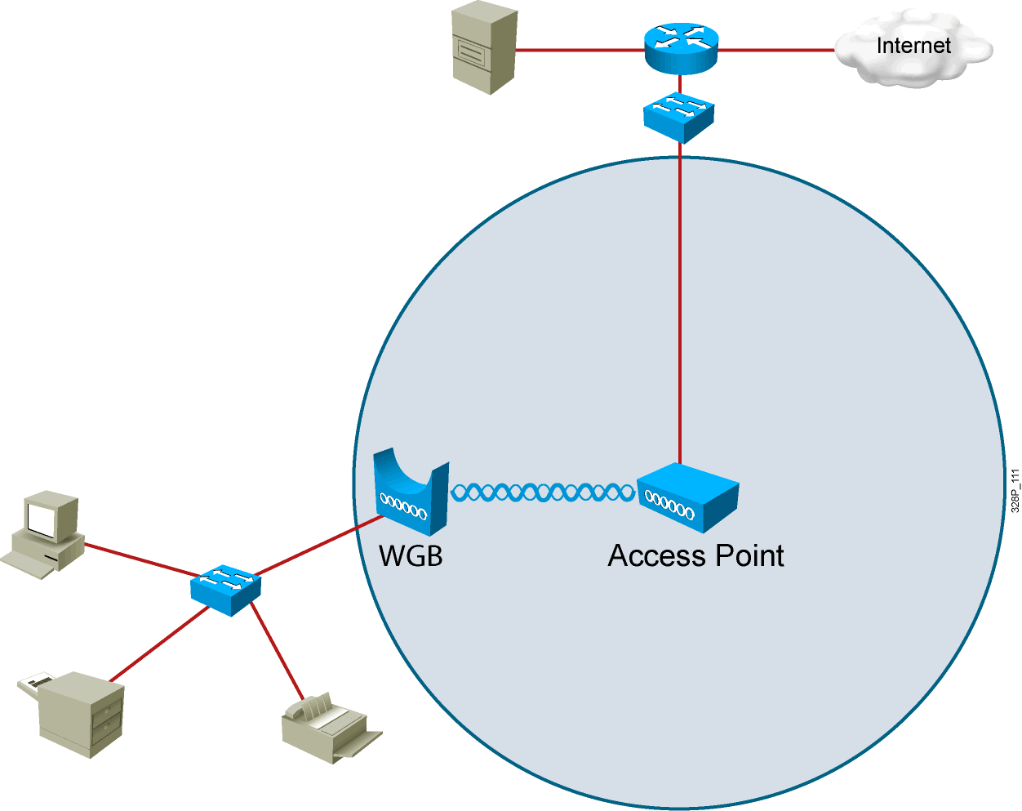
Workgroup Bridge
A WGB provides wireless connection from Ethernet port
Several devices can benefit if the WGB is connected to a hub or a switch.
1-18

Slide 38
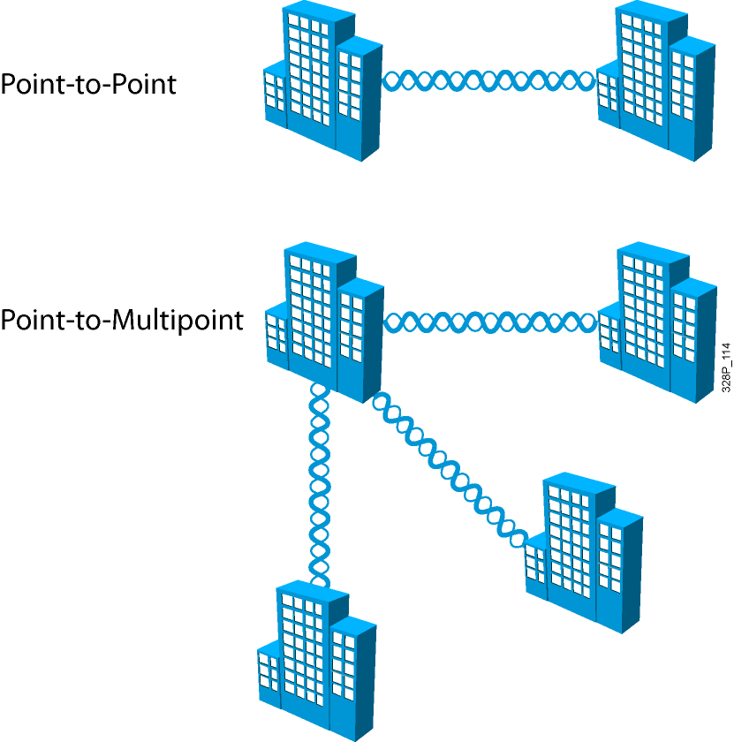
Outdoor Wireless Bridge
Extend the LAN by linking LANs
Usually a few miles
Range
Point to point or hub and spoke
1-20

Slide 39
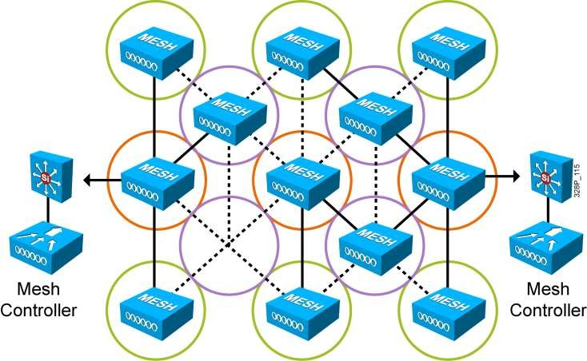
Mesh Networks
Devices are connected with redundant connection between nodes
No single point of failure

Slide 40
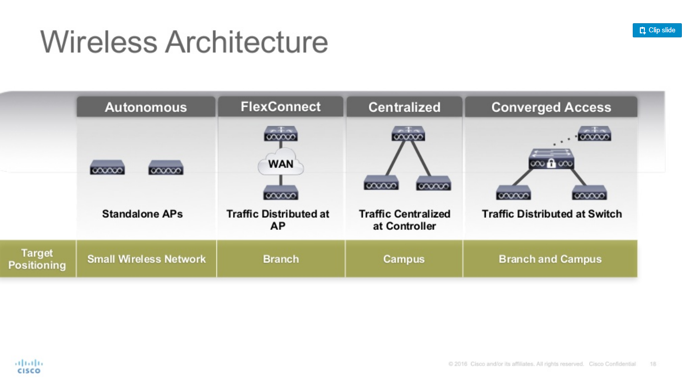
Wireless Architectures

Slide 41
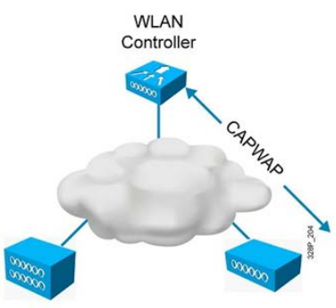
Cisco Split MAC Design
Cisco WLAN Controller
  Security policies
  QoS policies
  RF managemenr
  Mobility management
Cisco controller-based access point
  Remote RF interface
  Encryption downstream
  Decryption upstream

Slide 42
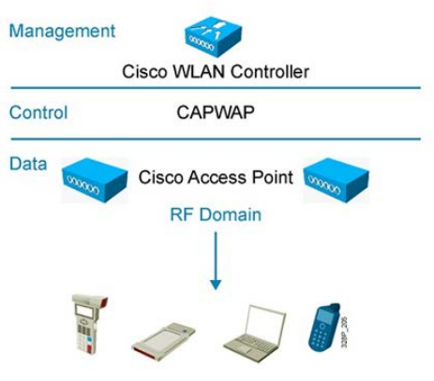
Dynamic RF management
Channel assignment
Transmit power adjustment
Interference avoidance
Coverage hole management
Load balancing
Capacity management

Slide 43
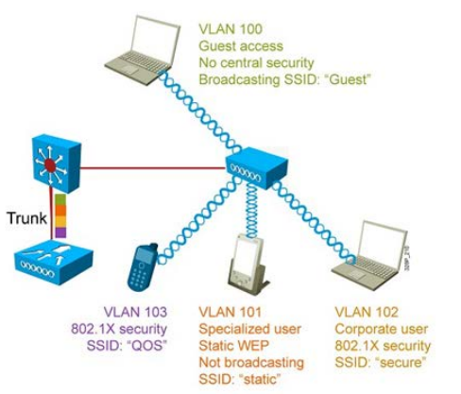
Wireless Virtual LAN Support
Multiple SSIDs
Multiple security types
Supports multiple VLANs from switches
IEEE 802.1Q Trunking protocol

Slide 44
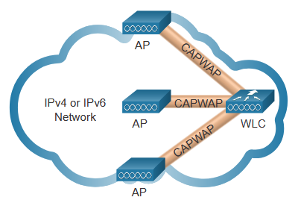
Introduction to CAPWAP
CAPWAP is an IEEE standard protocol that enables a WLC to manage multiple APs and WLANs.
Based on LWAPP but adds additional security with Datagram Transport Layer Security (DLTS).
Encapsulates and forwards WLAN client traffic between an AP and a WLC over tunnels using UDP ports 5246 and 5247.
Operates over both IPv4 and IPv6. IPv4 uses IP protocol 17 and IPv6 uses IP protocol 136.

Slide 45
Split MAC Architecture
The CAPWAP split MAC concept does all the functions normally performed by individual APs and distributes them between two functional components:
  AP MAC Functions
  WLC MAC Functions
AP MAC Functions | WLC MAC Functions
Beacons and probe responses | Authentication
Packet acknowledgements and retransmissions | Association and re-association of roaming clients
Frame queueing and packet prioritization | Frame translation to other protocols
MAC layer data encryption and decryption | Termination of 802.11 traffic on a wired interface

Slide 46
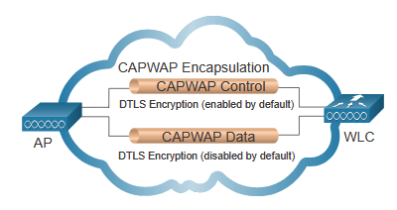
DTLS Encryption
DTLS provides security between the AP and the WLC.
It is enabled by default to secure the CAPWAP control channel and encrypt all management and control traffic between AP and WLC.
Data encryption is disabled by default and requires a DTLS license to be installed on the WLC before it can be enabled on the AP.

Slide 47
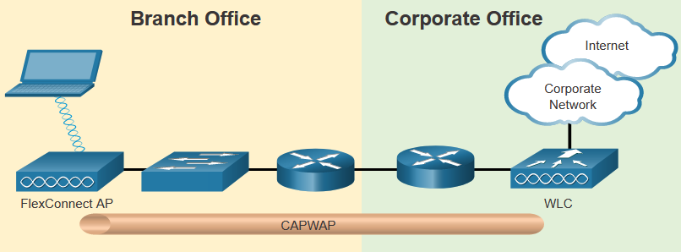
Flex Connect APs
FlexConnect enables the configuration and control of Aps over a WAN link.
There are two modes of option for the FlexConnect AP:
    Connected mode – The WLC is reachable. The FlexConnect AP has CAPWAP connectivity with the WLC through the CAPWAP tunnel. The WLC performs all CAPWAP functions.
    Standalone mode – The WLC is unreachable. The FlexConnect AP has lost CAPWAP connectivity with the WLC. The FlexConnect AP can assume some of the WLC functions such as switching client data traffic locally and performing client authentication locally.

Slide 48
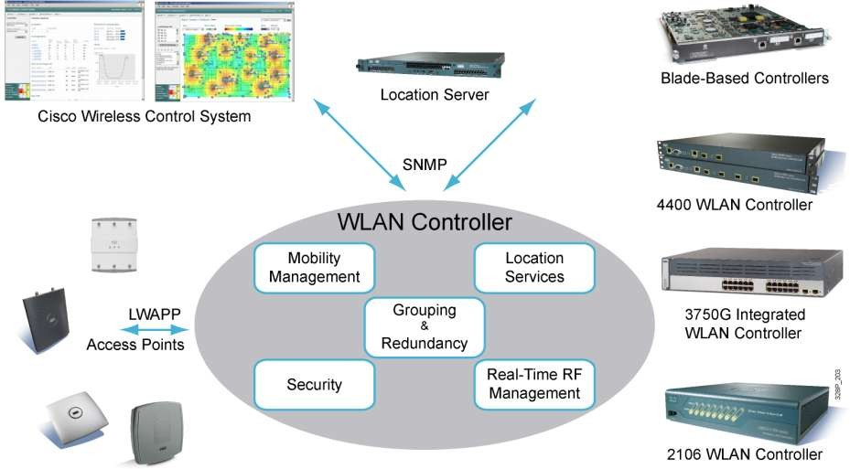
Controller-based Solution

Slide 49
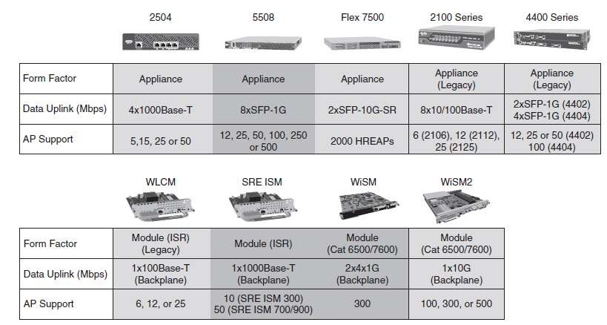
Controller Models

Slide 50
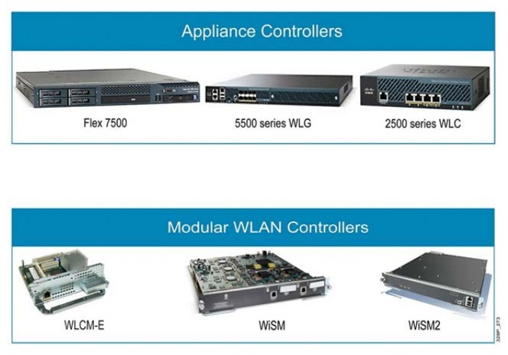
Controller Models

Slide 51
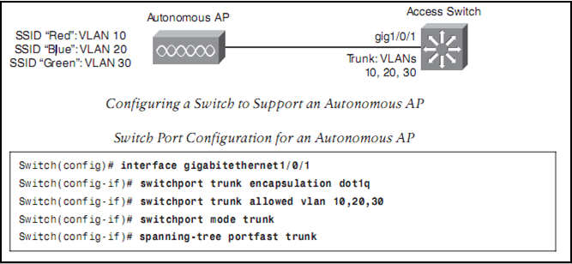
Configuring Switch Ports for Autonomous AP

Slide 52
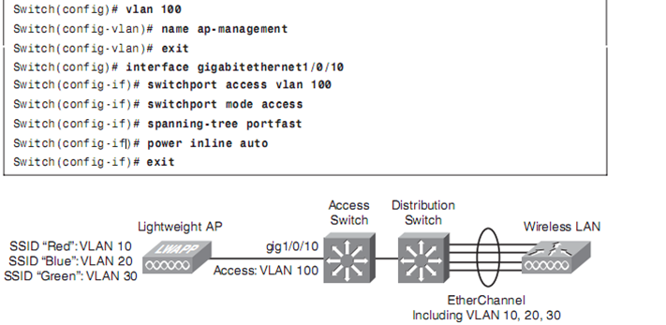
Configuring Switch Ports for Lightweight AP

Slide 53



phamthaikhanh@gmail.com
This Photo by Unknown Author is licensed under CC BY-NC

